Slide 1
Part 4 Network Layer
Chapter 19 Logical Addressing
Chapter 20 Internet Protocol
Chapter 21 Address Mapping, Error Reporting, and Multicasting
Chapter 22 Delivery, Forwarding, and Routing
Computer Networks
19-<number>

Slide 2
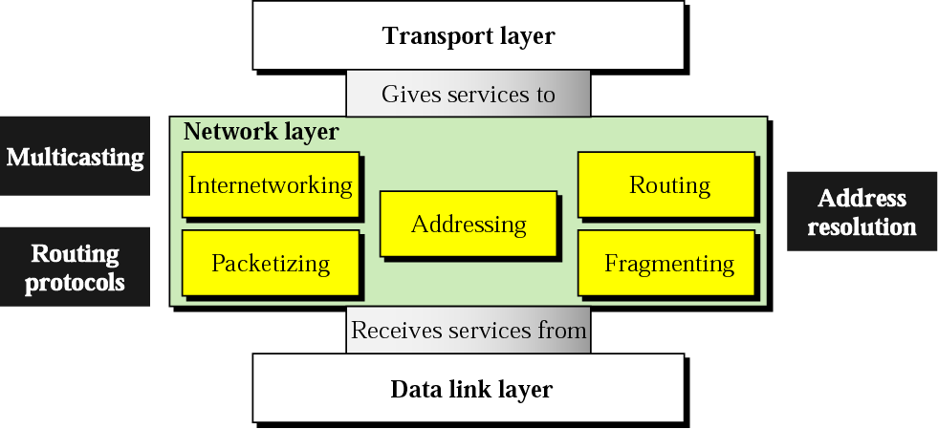
Position of network layer
The network layer is responsible for the delivery of individual packets from the source to the destination host
Computer Networks
19-<number>

Slide 3
Chapter 19.
Network Layer: Logical Addressing
19.1 IPv4 Addresses
19.2 IPv6 Addresses
Computer Networks
19-<number>

Slide 4
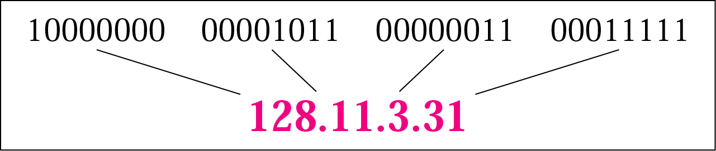
IPv4 Addresses
An IP address is a 32-bits long
The IP addresses are unique and universal
The address space of IPv4 is 2³² or 4,294,967,296
Binary notation: 01110101 10010101 00011101 00000010
Dotted-decimal notation: 117.149.29.2
Computer Networks
19-<number>

Slide 5
Example
Change the following IP addresses from binary notation to dotted-decimal notation.
a. 10000001 00001011 00001011 11101111
b. 11111001 10011011 11111011 00001111
We replace each group of 8 bits with its equivalent decimal number and add dots for separation:
a. 129.11.11.239
b. 249.155.251.15
Computer Networks
19-<number>

Slide 6

Classful addressing
In classful addressing, the address space is divided into five classes: A, B, C, D, E
A new architecture, called classless addressing was introduced in the mid-1990s
Computer Networks
19-<number>

Slide 7
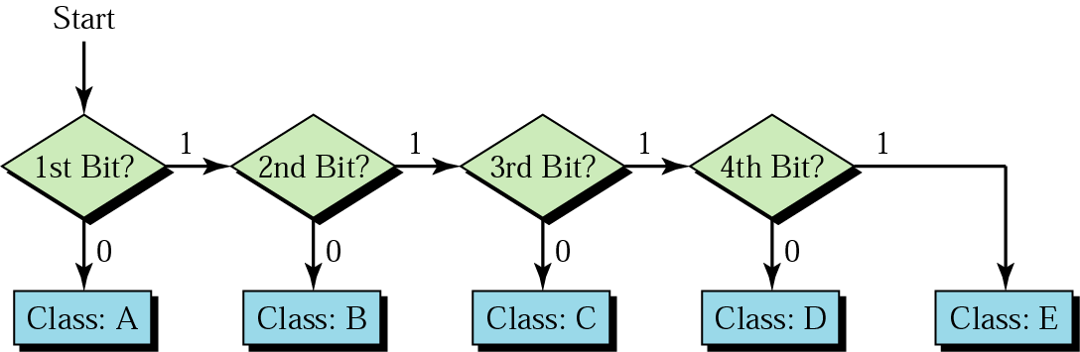
Finding the address class
Computer Networks
19-<number>

Slide 8
Classful Addressing: Example
Find the class of each address.
a. 00000001 00001011 00001011 11101111
b. 11000001 10000011 00011011 11111111
c. 14.23.120.8
d. 252.5.15.111
Solution
a. The first bit is 0. This is a class A address.
b. The first 2 bits are 1; the third bit is 0. This is a class C address.
c. The first byte is 14; the class is A.
d. The first byte is 252; the class is E.
Computer Networks
19-<number>

Slide 9

Classes and Blocks
In classful addressing, a large part of the available addresses were wasted
Computer Networks
19-<number>

Slide 10
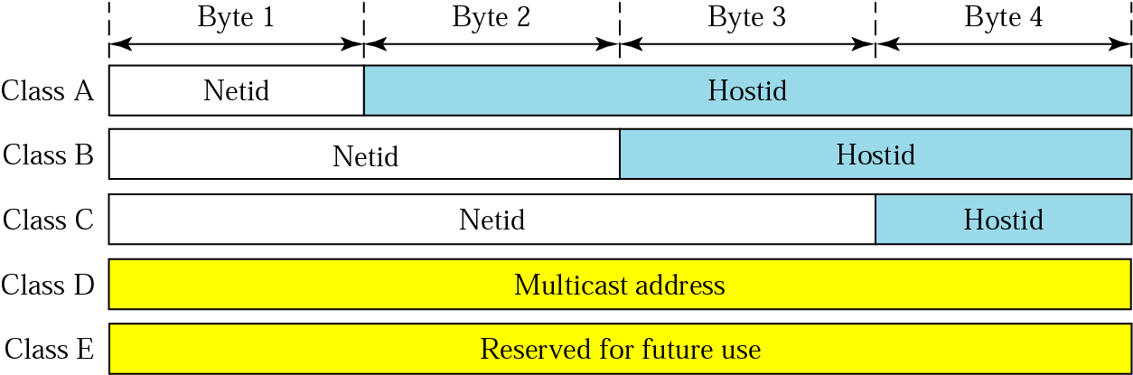
Netid and Hostid
IP address in classes A, B, and C is divided into netid and hostid
Computer Networks
19-<number>

Slide 11

Mask: Default Mask
The length of the netid and hostid is predetermined in classful addressing
Default masking
CIDR (Classless Interdomain Routing) notation
Computer Networks
19-<number>

Slide 12
Subnetting
Divide a large block of addresses into several contiguous groups and assign each group to smaller networks called subnets
Increase the number of 1s in the mask
Supernetting
Combine several class C blocks to create a larger range of addresses
Decrease the number of 1s in the mask (/24 → /22 for C addresses)
Computer Networks
19-<number>

Slide 13

Classless addressing
Classful addressing has created many problems
Many ISPs and service users need more addresses
Idea is to have variable-length blocks that belong to no class
Three restrictions on classless address blocks;
  The addresses in a block must be contiguous, one after another
  The number of addresses in a block must be a power of 2
  The first address must be evenly divisible by the number of addresses
Computer Networks
19-<number>

Slide 14
Mask and Address Blocks
In IPv4 addressing, a block of addresses can be defined as x.y.z.t /n in which x.y.z.t defines one of the addresses and the /n defines the mask.
The first address in the block can be found by setting the rightmost 32 − n bits to 0s
The last address in the block can be found by setting the rightmost 32 − n bits to 1s
The number of addresses in the block can be found by using the formula 2^{32−n}
Example: 205.16.37.39/28
  The binary representation is 1100110 00010000 00100101 00100111
  If we set 32 − 28 rightmost bits to 0, we get 11001101 00010000 00100101 00100000
  → 205.16.37.32 (First address)
  If we set 32 − 28 rightmost bits to 1, we get 11001101 00010000 00100101 00101111
  → 205.16.37.47 (Last address)
  The value of n is 28, which means that number of addresses is 2³²⁻²⁸ or 16
Computer Networks
19-<number>

Slide 15

Network Address
The first address in a block is normally not assigned to any device; it is used as the network address that represents the organization to the rest of the world
Hierarchy
Computer Networks
19-<number>

Slide 16

Two-Level Hierarchy: No Subnetting
Each address in the block can be considered as a two-level hierarchical structure:
the leftmost n bits (prefix) define the network; the rightmost 32 − n bits define
the host
Computer Networks
19-<number>

Slide 17


Three-Levels of Hierarchy: Subnetting
Computer Networks
19-<number>

Slide 18

Address Allocation and Distribution: Example
The first group has 64 customers; each needs 256 addresses.
The second group has 128 customers; each needs 128 addresses.
The third group has 128 customers; each needs 64 addresses.
Computer Networks
19-<number>

Slide 19
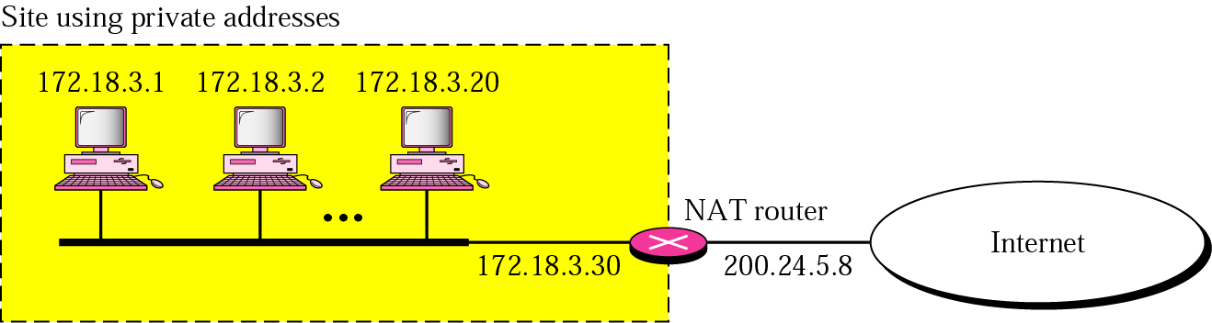
Network Address Translation: NAT
NAT enables a user to have a large set of addresses internally and one address, or a small set of addresses, externally.
Range | Total
10.0.0.0 to 10.255.255.255 | 2²⁴
172.16.0.0 to 172.31.255.255 | 2²⁰
192.168.0.0 to 192.168.255.255 | 2¹⁶
Addresses for private networks
Computer Networks
19-<number>

Slide 20
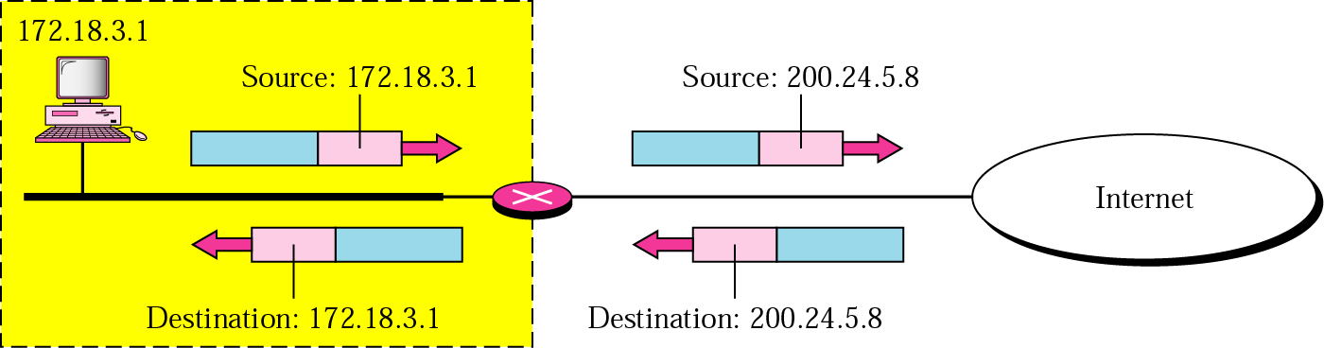
Addresses Translation
Address translation for source address of outgoing packet and for destination address of incoming packet
Computer Networks
19-<number>

Slide 21
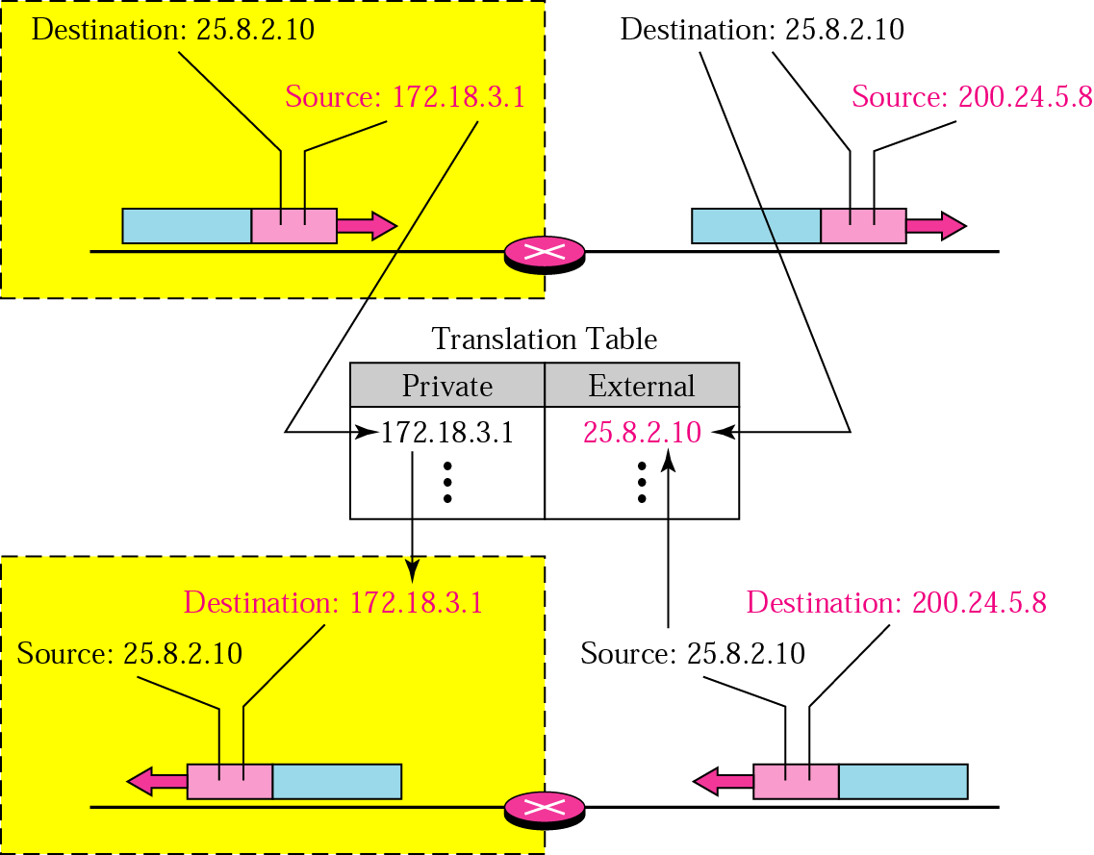
Translation Table
Using (1) one IP address, (2) a pool of IP address, and (3) both IP addresses and port numbers
Computer Networks
19-<number>

Slide 22


Five-Column Translation Table
ISP and NAT
Computer Networks
19-<number>

Slide 23


IPv6 Addresses
Despite all short-term solutions, such as classless addressing, DHCP (Dynamic Host Configuration Protocol), and NAT, still address-hungry
An IPv6 address is 128 bits long
Hexadecimal colon notation:
Abbreviation:
Computer Networks
19-<number>

Slide 24
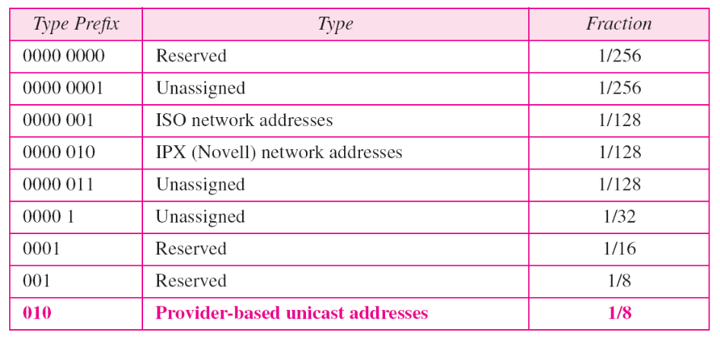
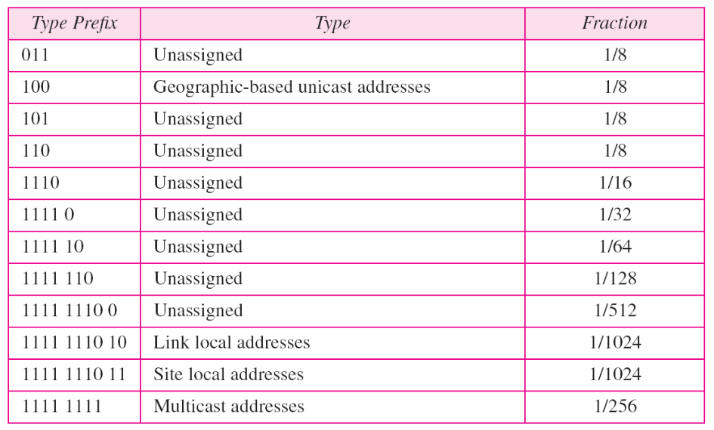
IPv6 Address Space
Computer Networks
19-<number>

Slide 25


IPv6 Addresses
Unicast addresses: define a single computer
  Two types: geographically based and provider-based
  Prefixes for provider-based unicast address
  Type id (3 bits), Registry id (5 bits)
Multicast addresses:
define a group of hosts
Computer Networks
19-<number>

Slide 26


IPv6 Addresses
Anycast addresses: define a group of nodes
  Unlike multicast, a packet is delivered to only one of the members of the anycast group, the nearest
Reserved addresses:
Local addresses: private networks
Computer Networks
19-<number>

